Slide 1

DATABASE MANAGEMENT SYSTEMS LABORATORY(CD252IA)
Experiential learning
Topic : Hospital Management System
Shashidhar Sarvi - 1RV22CD054
Harsha R B - 1RV23CD401
Harshit Savanur - 1RV23CD402

Slide 2

Problem Statement Developing a hospital management system in order to effectively manage most aspects of hospitals such as booking appointments, managing patient records and keeping medical history.
Problem Statement
Overview:
Organisations such as hospitals have to deal with a lot of patients regularly and hence a lot of data. Hence it is very important for a hospital to have a DBMS with a frontend that easily allows patients to book appointments and allows doctors or administrators to manage patient data.
For this project I have chosen to build the frontend using ReactJS and JavaScript, backend in Node.js and the database used will be MySQL.

Slide 3
Functional Requirements
Separate interfaces for patients and doctors. Patients and doctors should have separate logins.
Allow patients to book appointments and view/update/cancel them later if necessary, creating free slots for other patients.
Allow doctors to cancel appointments.
The system should avoid clash of appointments and allow appointments only when a doctor is not already busy or does not have a break.
Doctors should be able access patient history and profile, and add to patient history.
Doctors should be able to give prescriptions and diagnosis.

Slide 4
Literature Survey
AUTHOR | PAPER TITLE | PUBLISHED | SUMMARY
Khairil Anwar, Muhammad Fikry Aransyah, Sabina Natania Ibrahim, Febi Nurlita, Anisa Sasmita Sari, Nanda Marlinda | Assessing the success factors of Hospital Management Information System (HMIS) implementation using the HOT-FIT method in Indonesia | Published: 2023 Paper Link | This paper reviews the critical success factors influencing HMIS implementation. It highlights the importance of user satisfaction and system utilization, addressing organizational and human factors essential for effective healthcare management.
Neeraj Tiwari, Ashok Kumar Rai, Anurag Sahani, Akshay Kumar Maurya | Survey Paper On Hospital Management System (HMS) | Published: 2021 Paper Link | This paper presents a design for an HMS that assists patients at hospital front desks by providing information about doctors and appointments. It focuses on enhancing patient interaction and improving efficiency through technology integration.

Slide 5
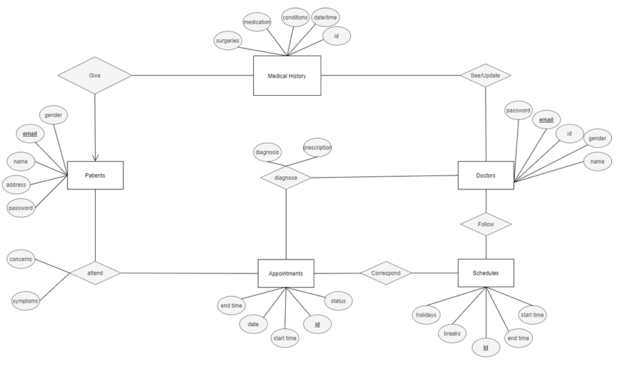
ER Diagram

Slide 6
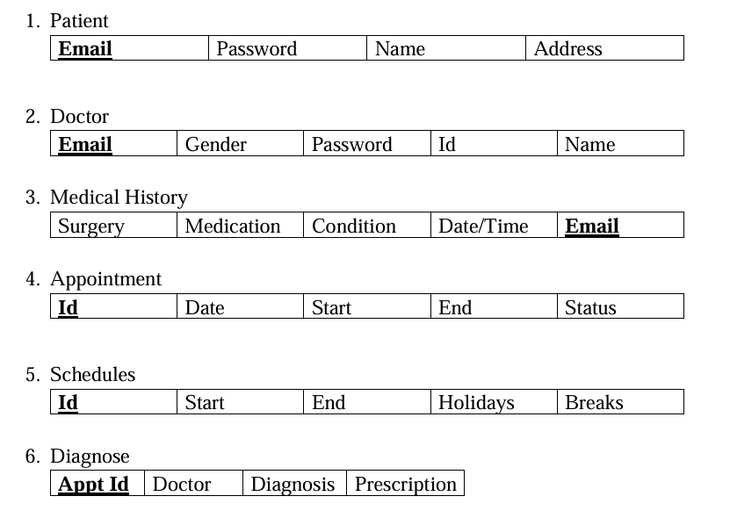
Relational Schemas

Slide 7
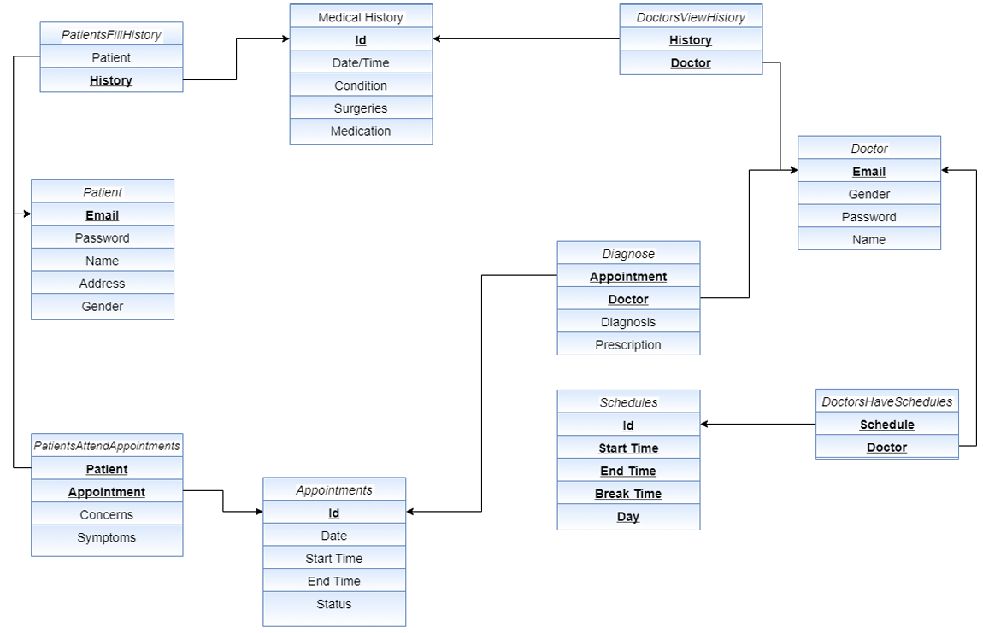
Relational Mapping

Slide 8
THANK YOU

